Slide 1
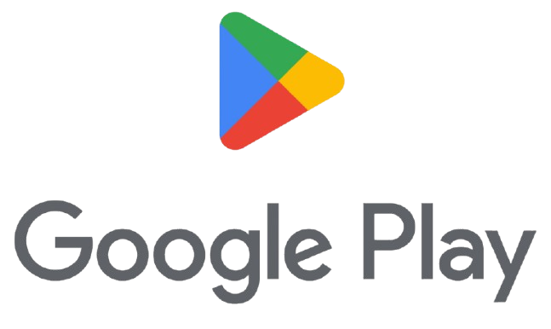
Google Play Store
Analysis Using Tableau

Slide 2
Introduction
The Google Play Store is Google's official digital storefront for Android devices, offering a wide range of content including apps, games, books, movies, and music.
It's a comprehensive platform where users can find millions of applications and games across various categories, along with user reviews and ratings to help make informed decisions.
Additionally, it provides access to a vast collection of e-books and a variety of movies and TV shows for purchase or rental. Overall, it's an essential hub for accessing diverse digital content seamlessly on Android devices.
Here we are analyzing the performances of apps in diff categories and genres according to installs ,ratings ,reviews ,etc. using Tableau.

Slide 3
Objective
The main objective of this project is to analyse the performance of each and every apps in the google play store by going through their Ratings, Installs, Reviews, etc and showing it in a visualized manner.
Through different charts and filters, the clear picture of each app’s performance is visualised in this project by using Tableau.

Slide 4
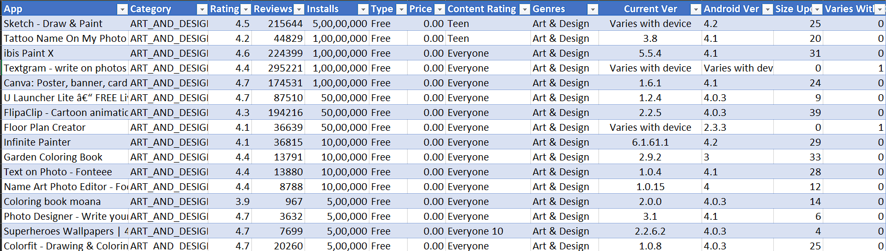
Dataset

Slide 5
Key Details
TOTAL ENTRIES : The dataset contains 8005 entries.
COLUMNS : There are 12 columns in the dataset.
1. App: The apps which are listed in Google Play Store.
2. Category: The category of each apps.
3. Rating: The customer ratings of each app.
4. Installs: Number of Installs by users.
5. Type: It shows whether the app is Free or Paid.
6. Price: The Price of each apps (some of the apps are paid).
7. Content Rating: Classification that indicate the suitability of media for different audiences.

Slide 6
8. Genres: It shows the Genre of the app.
9. Current Ver: It shows the current version of the app.
10. Android Ver: The android version of the device in which the app works.
11. Size Updated in MB: The size of the apps shown in megabytes.
12. Varies with Devices: The android version that varies with devices gives 1.

Slide 7
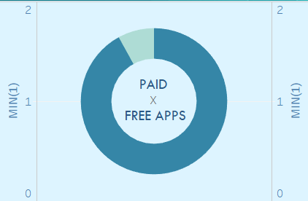
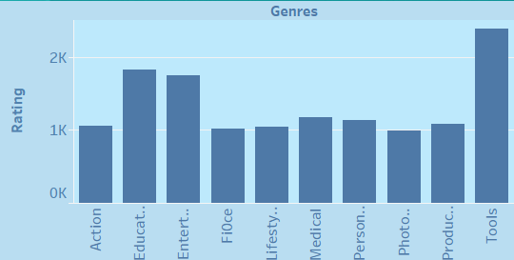
Criteria Used
1. Free Apps Vs Paid Apps
(Donut Chart)
2. Top 10 Genres by Rating
(Bar Chart)

Slide 8
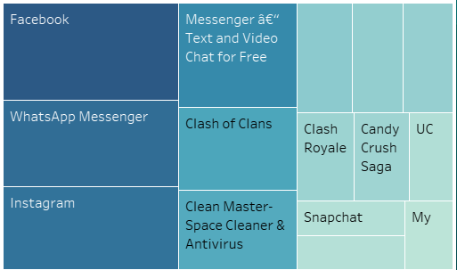
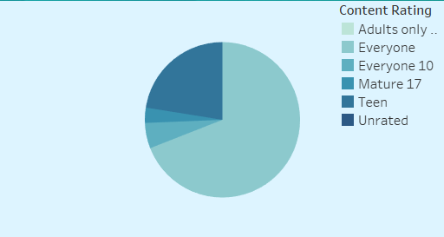
Criteria Used
3. Installs By Content Rating
(Pie Chart)
4. Top Reviewed 15 Apps
(Tree Map)

Slide 9
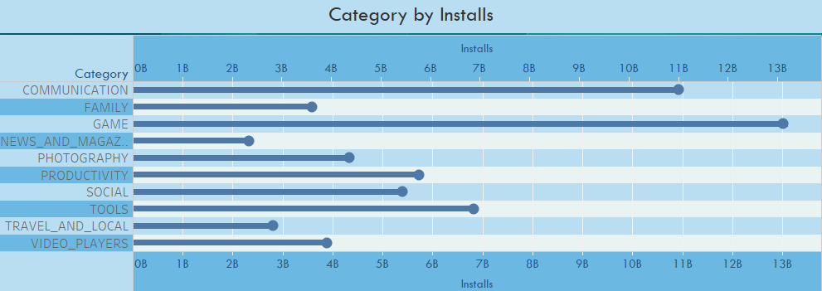
Criteria Used
5. Category by Installs
(Lollipop Chart)

Slide 10





Criteria Used
5. Filters

Slide 11
DASHBOARD

Slide 12
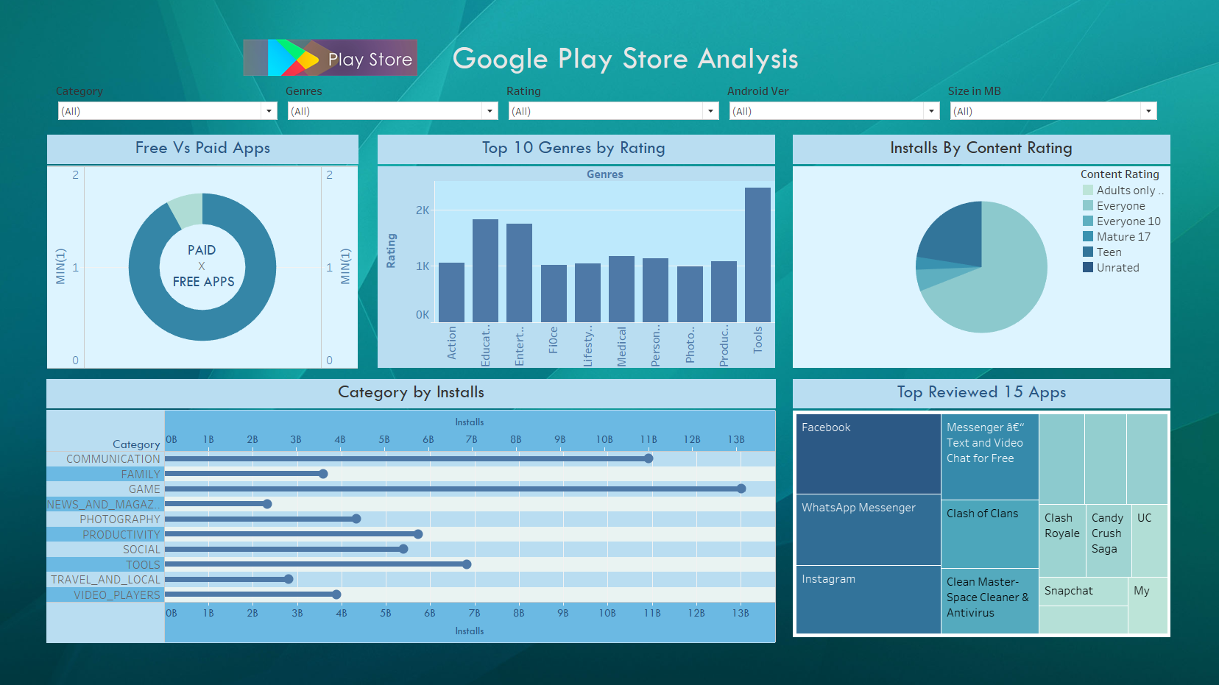

Slide 13
Conclusion
Leading Platform: Google Play Store remains the dominant app distribution platform for Android devices.
Top Installed Apps: Popular apps like Facebook, WhatsApp and Instagram are among the most installed, reflecting its global reach.
Top-Rated Apps: The Google Play Store features a range of highly-rated apps across categories, with users often praising them for functionality, design, and user experience.
User Reviews: Top-rated apps typically have high average ratings (4.5 stars and above) due to positive user feedback and frequent updates

Slide 14
References
https://github.com/shubhamringole/Capstone-Project-ON-Google-Play-store-Data-set-ON-Excel
Tableau - Visualisation

Slide 15
Thank You

